Slide 1
Livres
Auteur: Jules Verne

Slide 2

Le Tour du monde en quatre-vingts jours
Around The World In Eighty Days

Slide 3
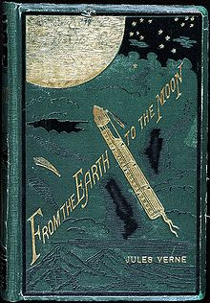
De la terre à la lune
From Earth To The Moon

Slide 4
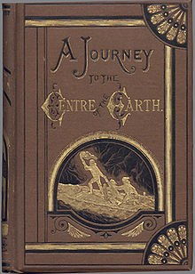
A Journey To The Centre Of The Earth
Voyage au centre de la terre

Slide 5
“An energetic man will succeed where an indolent one would vegetate and inevitably perish.”
Citations:
“A man of merit owes himself to the homage of the rest of mankind who recognize his worth.”
“Be it understood you are never rich when you get no advantage from it.”
“Man is never perfect nor contented.”

